Slide 1
Table of Contents
Welcome to KWK
Meet Your Houses & CoT1 (Part 1)
1. Intro to Mobile App Development
Lunch
2. Swift: Data Types & Variables
Brain Break 1
3. Swift: Conditional Statements
Closing Circle

Slide 2
Welcome to Day 1!

Slide 3


Welcome to
Kode With Klossy Summer 2025!
💬 We’ll get started in just a bit! As you’re joining:
Change your name on Zoom to include your house!
Turn your camera on and answer the questions below in the chat:
🌎 Where are you logging in from today? 🌎
🌡️ What’s the weather like where you are? 🌡️

Slide 4


Hi, I’m Nicole! (she/her)
Originally from Pennsylvania but currently living in Miami, FL 🌴
I taught Math 6-12 for 6 years in both MS and HS 🧮
I’m now a HS academic counselor! 🏫
Fun fact: I have a Terrier Mix named Twix 🐾, which is also my favorite candy! 🍫
‹#›

Slide 5

Hi, I’m Tracey! (she/her)
I am originally from New Orleans but currently live in Madison, Wisconsin 🧀
When not teaching camp, I teach in the education department at the University of Wisconsin and am writing a PhD dissertation ✏️
I love to go all out for halloween and make my own costumes (I’ve recently dressed up as a cactus 🌵 and a turkey 🦃)
‹#›

Slide 6




Welcome to KWK!
We’re so glad that you’re here!
This summer, you are joining a community of 2000+ KWK scholars!
‹#›

Slide 7


Slide 8


Slide 9
What stands out to you about Kayley’s experience?

Slide 10
Your Kode With Klossy Journey

Slide 11
A Day in the Life
9:30 AM - 9:50 AM | Opening Circle
9:50 AM - 12:00 PM | Morning technical sessions + brain breaks + Culture of Tech sessions
12:00 PM - 12:45 PM | Lunch time
12:45 PM - 2:40 PM | Afternoon technical sessions + brain breaks + Culture of Tech sessions
2:40 PM - 3:00 PM | Closing Circle

Slide 12

‹#›

Slide 13

THE CLOUD
‹#›

Slide 14


Instructors
‹#›

Slide 15

HOUSES
‹#›

Slide 16

IAs
‹#›

Slide 17
‹#›

Slide 18
‹#›

Slide 19
‹#›

Slide 20
‹#›

Slide 21
‹#›

Slide 22
‹#›

Slide 23

VCC
‹#›

Slide 24

Hi, I’m Geetika! (she/her)
I was a scholar in 2022 in the MA camp and an IA in 2023! This is my first year as a VCC :)
I am majoring in Economics and International Relations at UC Davis
I am currently on a year abroad and I live in Berlin, Germany!!
‹#›

Slide 25
Norms

Slide 26

Norms - Breaks
We have scheduled breaks throughout the day!
If you need a break before then, turn off your camera and take a break!
If you know you’ll have an interruption in advance, please let your IAs know before the session.

Slide 27

Norms - Attendance
Camp runs every day from 9:30am to 3:00pm!
If you can’t attend any part of camp, please let your IAs know!
Be sure to message both IAs when notifying them!

Slide 28

Norms - Supplies
Before each meeting:
Use headphones 🎧
Grab your notebook 📒
Get excited for sessions full of learning, community-building and Kode With Klossy magic ✨

Slide 29

Norms - Zoom Basics
Camera on when possible, especially in House breakouts
Mute when you’re not speaking
Virtual backgrounds are great!
Use the raise hand reaction or the chat to share ideas or ask questions

Slide 30

Norms - Zoom Breakouts
Wait before/after you speak
It’s easy to talk over people in remote settings, if you do, apologize and then let them finish
If you’re struggling with your Internet connection, you can always use the chat to share instead!

Slide 31
Key Tools & Resources

Slide 32
Key Tools & Resources
Zoom
Slack
Curriculum Site
Quick Links
‹#›

Slide 33
Key Tools & Resources
Zoom
Slack
Curriculum Site
Quick Links
‹#›

Slide 34
Zoom
Zoom has many built-in features, some of which you might already know how to use!
Polls
Reactions
Annotate
Breakout Rooms

Slide 35
Zoom Polls
Let’s try responding to a poll right now!
How much prior experience do you have with Computer Science? Respond in the zoom poll that popped up on your screen!

Slide 36

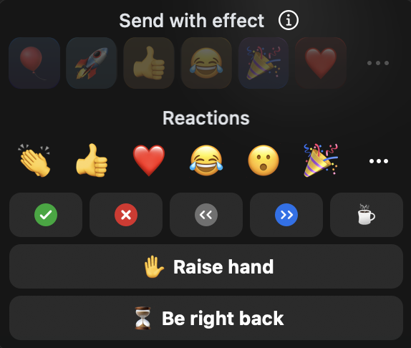
Zoom Reactions
Now, show me your favorite emoji! Click on the React button on your zoom toolbar and then the three dots to select your favorite emoji.

Slide 37
Zoom Reactions
These reactions are a little different! They will persist or stay longer than the quick reactions. Try clicking the green check reaction button!

Slide 38
Zoom Annotate
Select the Annotate tool from your Zoom toolbar to add your name or a stamp on the side you prefer!
CATS
DOGS

Slide 39
Zoom Breakout Rooms
We’ll be using breakout rooms A LOT throughout camp. To help us out, please update your Zoom name to display your House, name and pronouns every time you join Zoom! For example:
B - Ada (ay-duh) Lovelace - she/hers
Let’s update those now! Find your name in the participants panel and click More > Rename.

Slide 40
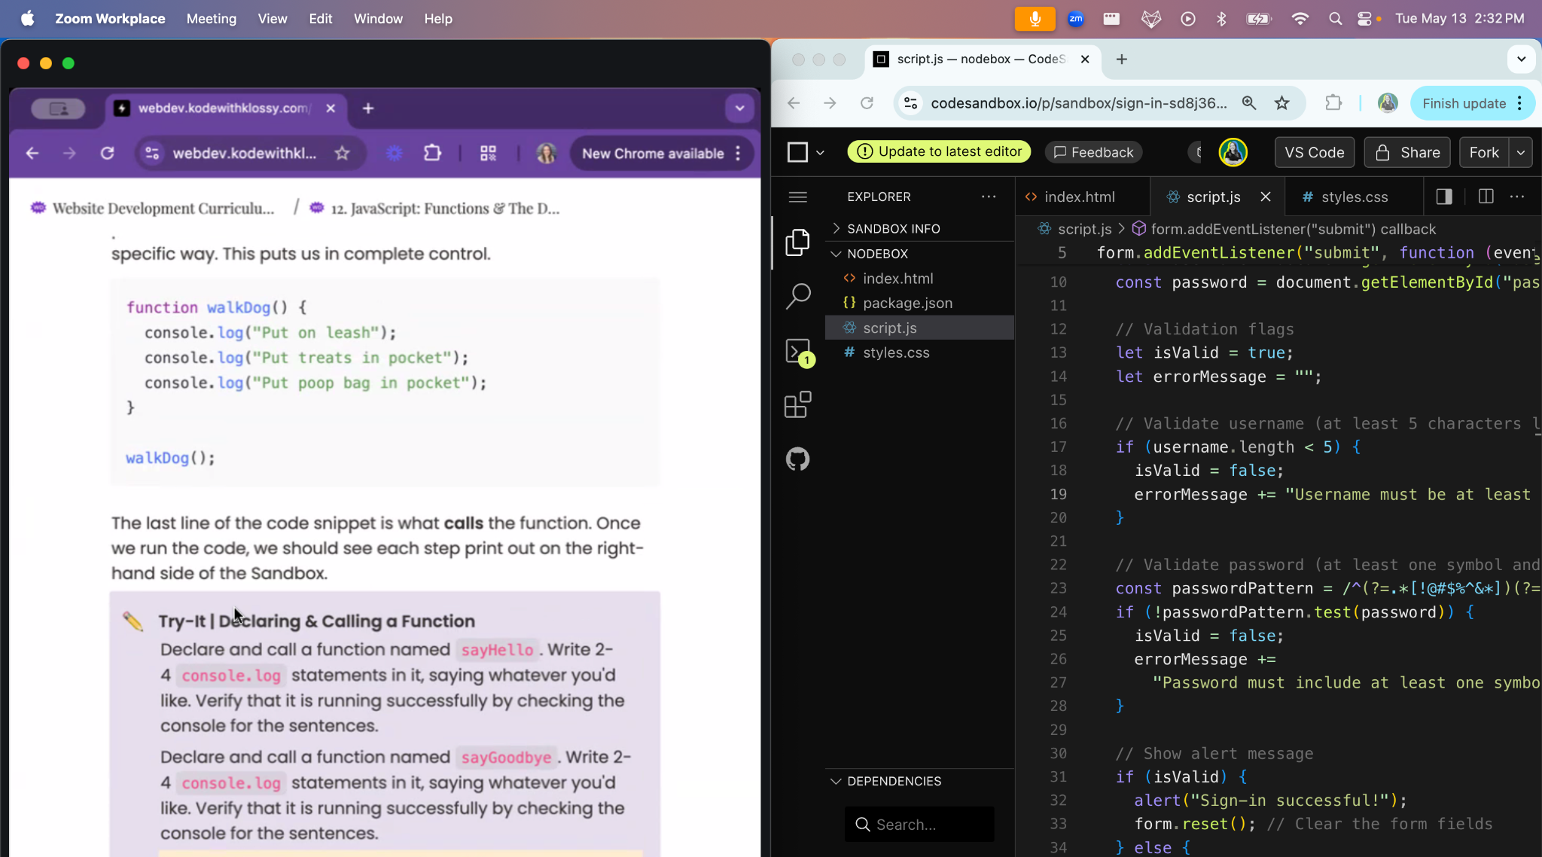

Slide 41
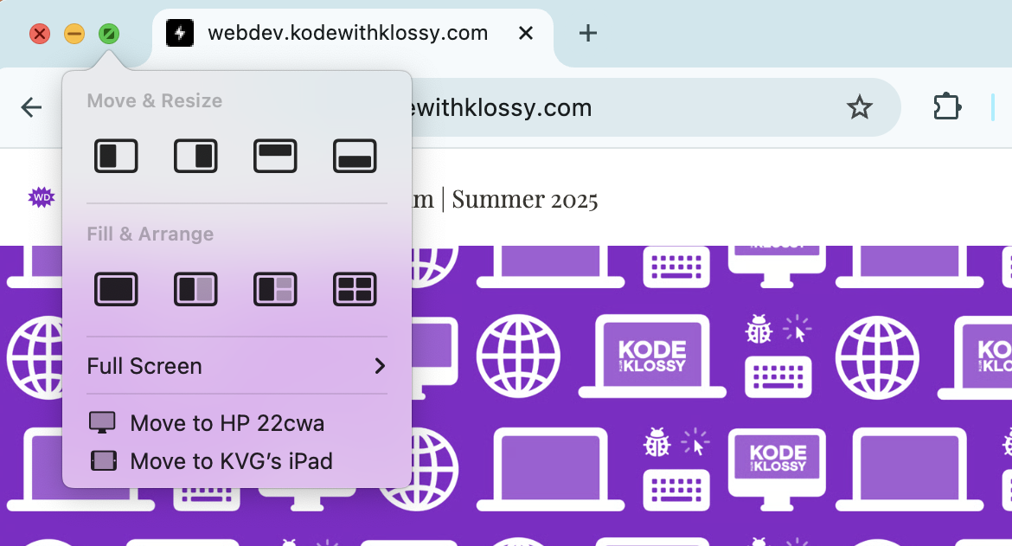
Split Screen For Mac
Hover your cursor over the green button in the upper-left corner of a window (or click and hold the button).
Choose the placement you want for that window!

Slide 42
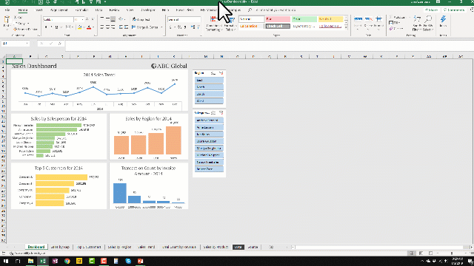
Split Screen For PC
Click and hold the top of the window and drag it to the left or the right. Release when a light outline of the new placement appears.
On the opposite side of the screen, select one of the other open windows.

Slide 43
Key Tools & Resources
Zoom
Slack
Curriculum Site
Quick Links
‹#›

Slide 44
Slack
Slack is our primary tool for communication, including announcements or important questions!
Chat with other scholars in organized spaces called “channels”
Share files and links instantly
It’s a tool many professionals use in their daily work environments!

Slide 45
If you need to send a direct message, please include 2 instructors so we can support you together!

Slide 46
Slack Channels
🏠 House channel
Who: ~20 scholars and the co-IAs assigned to that house
What: A space for scholars to share technical questions, attendance concerns, and ideas with each other and their House IAs!
⛺️Whole camp channel
Who: All scholars in camp, all IAs, and instructors
What: Anything that is channel-wide! This can be key announcements, fun information, and highlights.

Slide 47
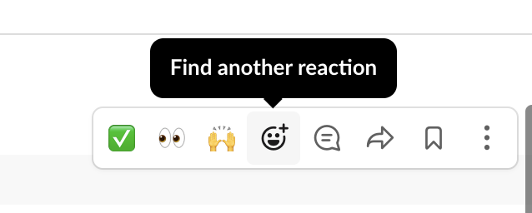

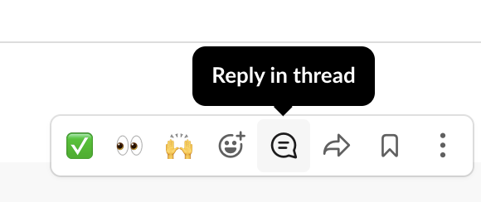
Slack Practice: Camp
Find your CAMP channel!
STEP 1: React to the message with your favorite emoji!
STEP 2: Reply in the thread with a mention to me (use @Nicole Bond)

Slide 48
Slack Practice: Houses
Find your HOUSE channel!
STEP 1: React to the question your IA posted with your favorite emoji!
STEP 2: Reply in the thread with your response!

Slide 49
Zoom Chat versus Slack Messaging?
Zoom Chat | Slack House Channel | Slack DM
“Can you please go back to the last slide with directions?” “Why do we need to add a semicolon?” “How can we make images on our website smaller?” | “I typed in <p> Rainbows <p> and nothing is showing up.” “How much more time do we have to practice?” “Does anyone know why my code isn’t loading?” | “I have an orthodontist appointment tomorrow morning. I will miss the first 30 minutes of camp. So sorry!” “I wanted to let you both know that I had a hard time keeping up with the lesson today because I was in a loud place in my house.”

Slide 50
Key Tools & Resources
Zoom
Slack
Curriculum Site
Quick Links
‹#›

Slide 51
Curriculum Site
This site includes all learning session materials for you to reference throughout camp!
You may use it during technical sessions
Or to refer back to later
Includes quick reference pages
Bookmark this page to access it quickly!

Slide 52

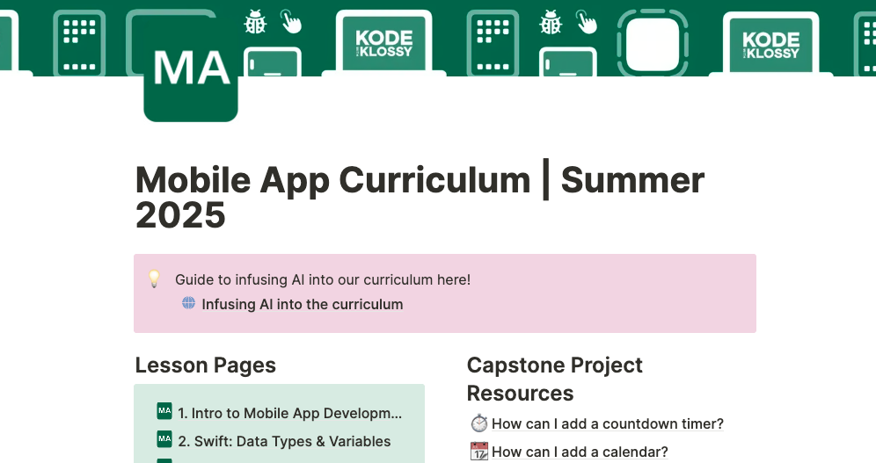



mobileapp.kodewithklossy.com (password: mobilemagicians)
‹#›

Slide 53
Key Tools & Resources
Zoom
Slack
Curriculum Site
Quick Links
‹#›

Slide 54
Quick Links
This resource has everything specific to our camp all organized by day!
Slides
Resources
Announcements
Collaborative Playlist
Please bookmark this resource!

Slide 55
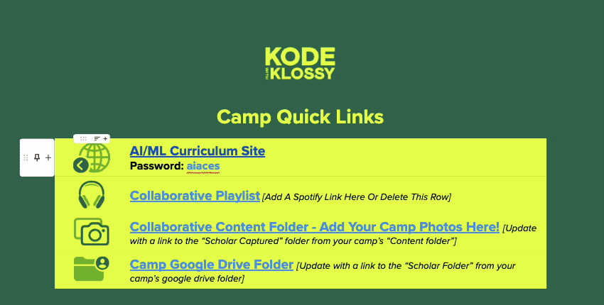
Bookmark this resource to reference daily!
‹#›

Slide 56


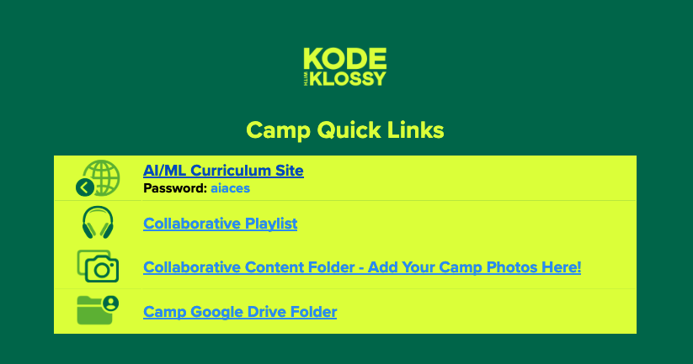

Share your scholar journey!
Take pics/vids of your experience!
Follow us on socials!!! 📱
Tag us!!!
The Kode With Klossy team would LOVE to see them! 💚

Slide 57
AI at Kode With Klossy

Slide 58
AI is driving innovation across industries.

Slide 59
We want to help you to be critical consumers and responsible creators of AI.

Slide 60
Foundational programming skills remain essential.

Slide 61
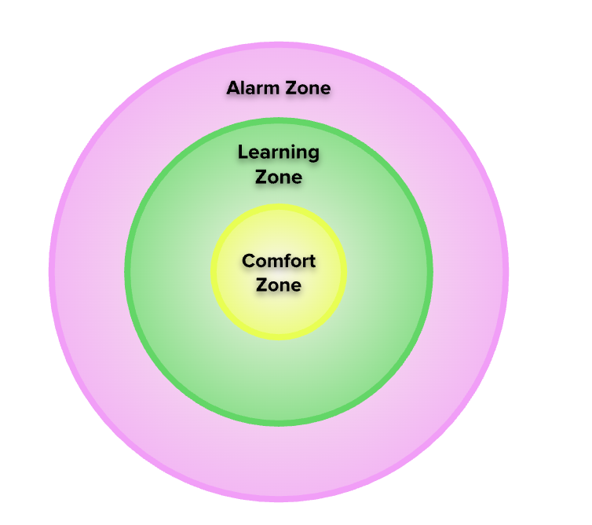
Learning Zone
Your Comfort Zone: The tasks which you can do easily, on your own, without much difficulty.
Your Learning Zone: The tasks which you can do by leaning on a reference, like a video or an article, or with a little help or guidance from someone with more expertise.
Your Alarm Zone: The tasks which you have no idea how to even start on, and which can make you feel overwhelmed, confused, and lost.

Slide 62
The (Scholar) AI Compass
When can these AI tools help your own capabilities and confidence, and when do they harm those things? When can they assist in learning a new skill, and when are they a substitute for real learning?
Your Comfort Zone: The tasks which you can do easily, on your own, without much difficulty.
Your Learning Zone: The tasks which you can do by leaning on a reference, like a video or an article, or with a little help or guidance from someone with more expertise.
Your Alarm Zone: The tasks which you have no idea how to even start on, and which can make you feel overwhelmed, confused, and lost.

Slide 63
So, what does this look like in practice?
A KWK prompt tells me to, “Use a python variable called `age` to store a number.”
But I don’t even know what a variable is!
Unproductive Use of AI
Productive Use of AI

Slide 64
So, what does this look like in practice?
A KWK prompt tells me to, “Use a python variable called `age` to store a number.”
But I don’t even know what a variable is!
Unproductive Use of AI
Productive Use of AI
Tell an AI tool: “Use a python variable called age to store a number.”
Copy and paste the AI’s output into CodeSandbox. Move on to the next prompt.

Slide 65
So, what does this look like in practice?
In the chat: why might this be an unproductive use of AI?
A KWK prompt tells me to, “Use a python variable called `age` to store a number.”
But I don’t even know what a variable is!
Unproductive Use of AI
Productive Use of AI
Tell an AI tool: “Use a python variable called age to store a number.”
Copy and paste the AI’s output into CodeSandbox. Move on to the next prompt.

Slide 66
So, what does this look like in practice?
A KWK prompt tells me to, “Use a python variable called `age` to store a number.”
But I don’t even know what a variable is!
Unproductive Use of AI
Productive Use of AI
Tell an AI tool: “Use a python variable called age to store a number.”
Copy and paste the AI’s output into CodeSandbox. Move on to the next prompt.
Ask an AI tool: “Can you help me understand what a variable is? I’m working in python.”
Read and understand the AI’s answer. Then, try to complete the prompt on your own.
If you need more help, ask the AI a clarifying question or reach out to an IL or a fellow scholar.

Slide 67
So, what does this look like in practice?
A KWK prompt tells me to, “Use a python variable called `age` to store a number.”
But I don’t even know what a variable is!
Unproductive Use of AI
Productive Use of AI
Tell an AI tool: “Use a python variable called age to store a number.”
Copy and paste the AI’s output into CodeSandbox. Move on to the next prompt.
Ask an AI tool: “Can you help me understand what a variable is? I’m working in python.”
Read and understand the AI’s answer. Then, try to complete the prompt on your own.
If you need more help, ask the AI a clarifying question or reach out to an IL or a fellow scholar.

Slide 68

Brain Breaks
Taking care of ourselves by taking breaks is incredibly important in the learning process.
Throughout camp, we will have BREAK BREAKS and BRAIN BREAKS.
Break breaks are time spent away from the computer and time for yourself.
Brain breaks are energizers, team-builders, and games to get to know other scholars!
‹#›

Slide 69

Break
Break

Slide 70


WELCOME BACK!
‹#›

Slide 71
Culture of Tech
Kode With Klossy
and Me

Slide 72

Norms for this session
Accept everyone's story as truth
Ask instead of assume
Be mindful of your position and power

Slide 73
Set Up Your Journal
We recommend that you use a journal to reflect during Culture of Tech sessions.
Journal reflections are for YOU.
Culture of Tech sessions:
Kode With Klossy and Me (Day 1 & 2)
Creating Opportunity
AI Ethics

Slide 74

Independent Reflection
How are you feeling right now?
What led you to apply to Kode With Klossy?
What have been some of your most powerful learning community experiences thus far?

Slide 75
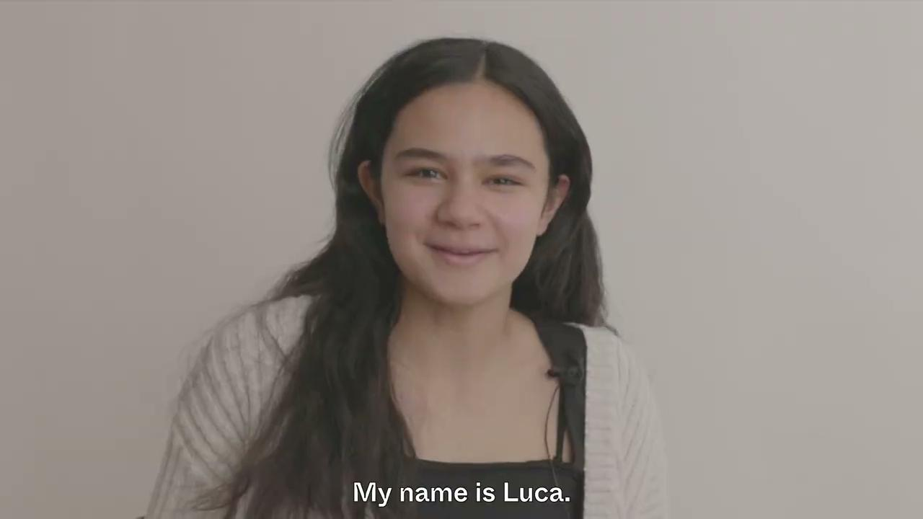

Slide 76
Independent Reflection
What resonated with you in this video? How are you feeling this morning?
What are you hoping to gain from KWK?
What’s something you’re excited for, a little nervous about, and one way you want to challenge yourself?
Hold on to these thoughts, we’ll share in Houses in a minute!

Slide 77
Let’s go meet your House!

Slide 78
WELCOME BACK!
‹#›

Slide 79
Kode With Klossy Commitments
01 - We disrupt the status quo.
02 - We meet ourselves and others where we are.
03 - We make it safe for everyone’s voice to be heard.
04 - We have boundless curiosity.
05 - We dream big and aim high.
06 - We dare to take risks.
07 - We are all lifelong learners.
What do these commitments mean to me? What might it look and sound like for us to live out these commitments?

Slide 80
How We’ll Help You Live Out Our Commitments
We will challenge you.
We will support your growth.
We will provide a safe, supportive, and fun environment.
We will nurture your creativity and passions.
We will make you feel welcome - you are part of the Kode With Klossy community now!

Slide 81

Let’s get started with our first technical session!
‹#›

Slide 82

“Notes” at KWK
We’re about to start our first lesson at KWK! (🥳)
At KWK, we don’t prescribe how you should take notes: what matters most is that you’re engaged in a way that works for you.
📓 Journal?
💻 Google Doc?
👂 Just listening deeply?
👉 Take a moment to settle in, open whatever works for you, and get ready to learn!

Slide 83
Intro to Mobile App Development
Our first technical session – Yay! 🎉

Slide 84
Identify tools for building Mobile Applications
Understand the difference between Swift and SwiftUI
Explain the purpose of a framework

Slide 85
Mobile App Development
Front-End Development
Back-End Development
Swift
SwiftUI
Framework
Xcode

Slide 86


Warm-Up
Share your answers to the following questions.
What are some of your favorite mobile applications?
What are your favorite features in these mobile applications?
What common features do your favorite apps share?
3 min

Slide 87
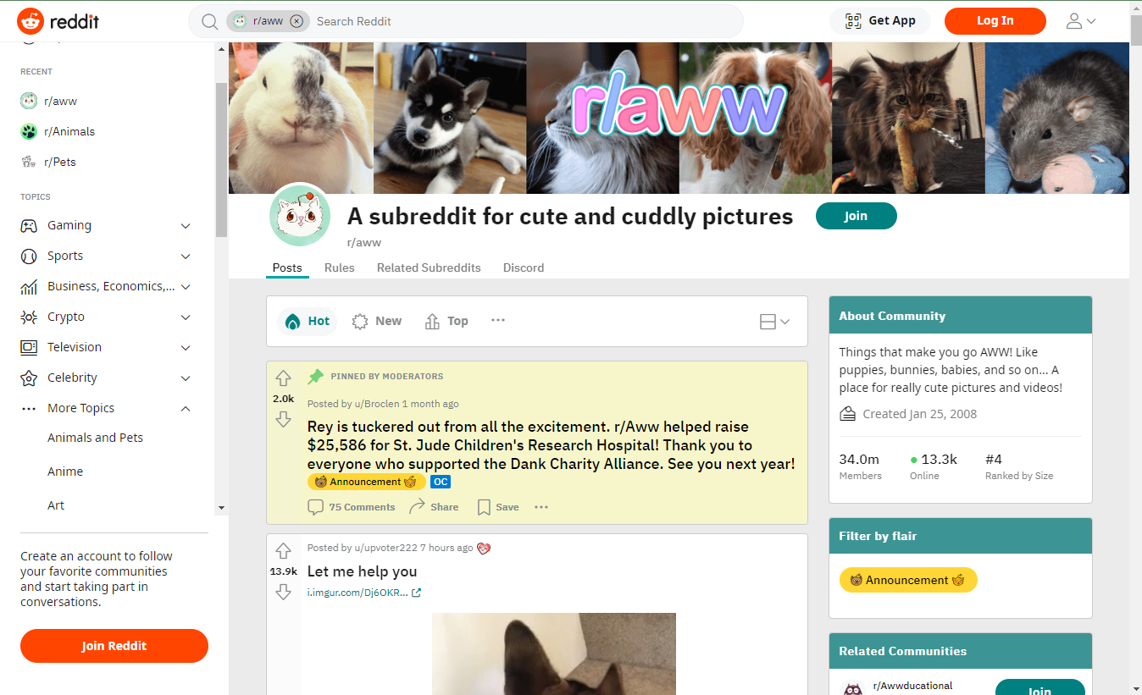
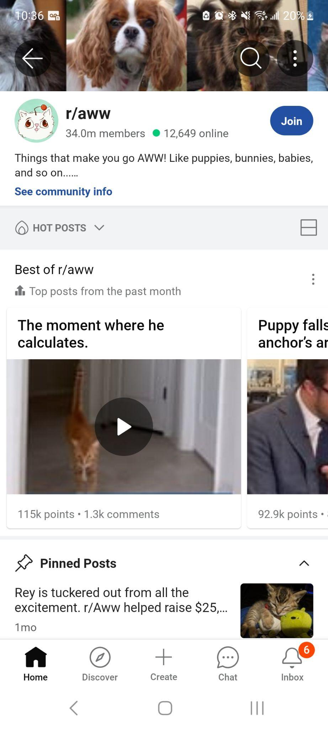
What is Mobile App Development?
Mobile app development is the work involved in building a mobile application for a specific device or set of devices. Mobile applications, also referred to as native applications, run directly on a device, unlike web applications which run in the browser (either on a computer, tablet, or phone).

Slide 88
Front-End vs. Back-End
Front-End Developers
Back-End Developers
Focus on the parts of a mobile app that users interact with directly.
Write code that brings designs to life, takes in user information, and updates what the user sees.
Focus on the parts of a mobile app that are hidden from the user such as collecting and storing data.

Slide 89
Mobile App Development Tools
Swift
SwiftUI
Xcode
A powerful programming language for logic and functionality
A framework for building user interfaces
All-in-one workspace to code, design, and test mobile apps

Slide 90
What is Swift?
Swift is a programming language developed by Apple.
designed to be an intuitive programming language, making it a great language to learn for both new and seasoned coders
a safe programming language, meaning that it is designed to prevent bugs and errors
an open-source language, meaning that developers at Apple and outside contributors are consistently working to address any bugs and make improvements

Slide 91
Swift Example
Here is an example of some Swift code from a future lesson:
var queen = "Beyoncé"
if queen == "Beyoncé" {
print("You are correct!")
} else {
print("Beyoncé is the only queen.")
}

Slide 92
What is SwiftUI?
SwiftUI is a framework written in Swift for building user interfaces for iOS, tvOS, macOS, and watchOS.
A framework is a collection of pre-built tools, components, and libraries that developers can use to build applications more efficiently.

Slide 93

What is SwiftUI?
All cars share common components–like a steering wheel, pedals, and a body frame.
Engineers don’t build these components from scratch! They use standardized components to streamline the process.
Similarly, SwiftUI provides pre-built UI components for building an app interface!

Slide 94

SwiftUI Example
Here is an example of SwiftUI in action.
How does the code on the left relate to the User Interface on the right?
Text("Hello, World!")
.font(.title)
.fontWeight(.bold)
.foregroundColor(Color.blue)

Slide 95
What is Xcode?
Xcode is Apple’s Integrated Development Environment (IDE) used for creating apps for Apple platforms.
Think of Xcode as the the application where developers build, test, and debug their apps.

Slide 96
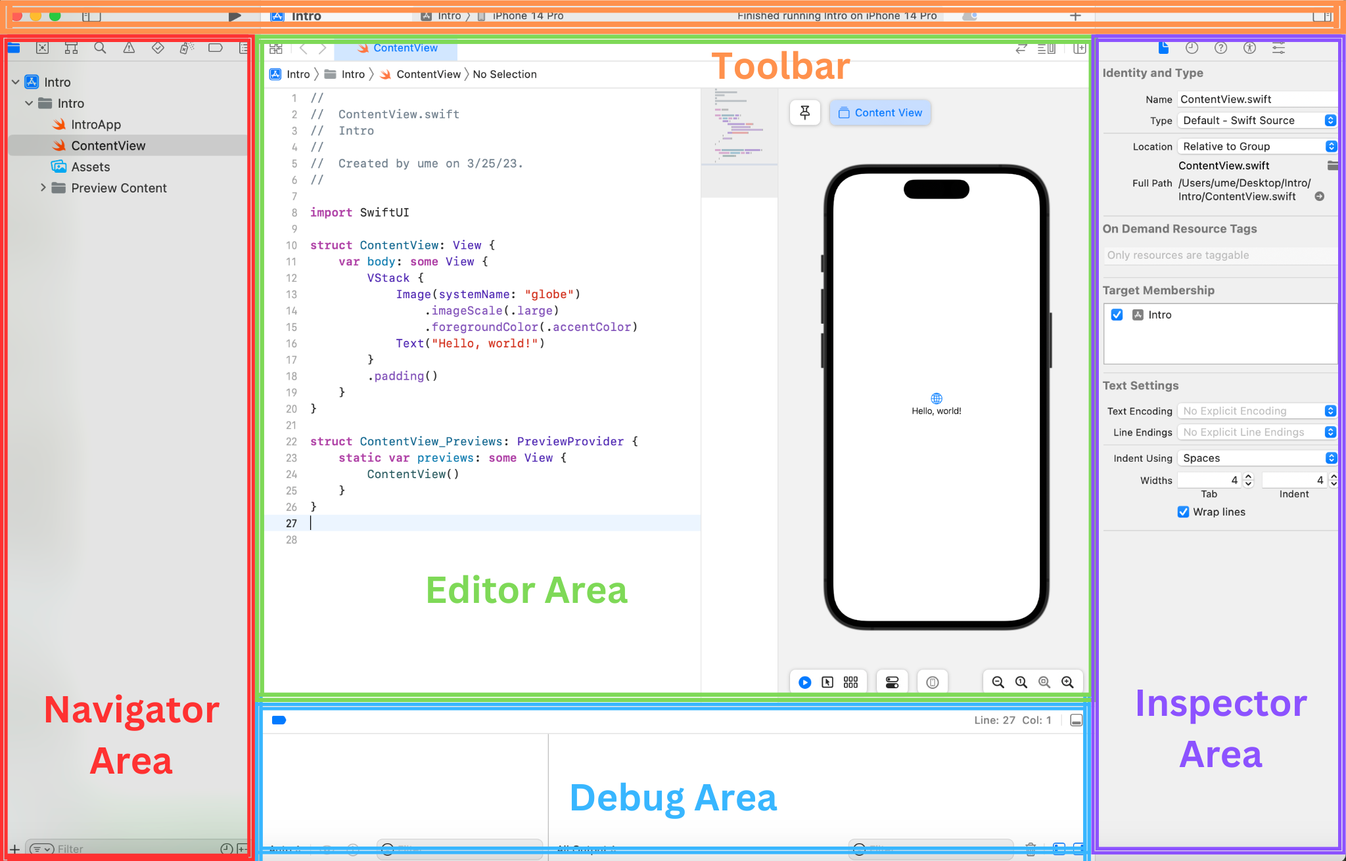

Slide 97
How do these tools work together?
Imagine you're designing a simple app to store all of your friends’ birthdays.
Swift provides the functionality to add new birthdays and sort them by date.
SwiftUI lets you quickly design the layout of your app with a text field to enter a friend's name and birthday and a button to add the new entry to the list.
Xcode brings everything together, allowing you to work with Swift and SwiftUI in one place.

Slide 98


Development Tools Recap
Xcode
development environment where we code, design, and test our apps
Swift
programming language that allows us to tell our programs what to do
SwiftUI
a framework; a tool for quickly designing the user interface
‹#›

Slide 99

Kode with Klossy Mobile App Development Scholars
Get ready to dive into the world of mobile app development! You'll start by learning the basics of Swift and mastering professional tools like Xcode and SwiftUI.
Working in teams, you’ll choose a topic that excites you and create your very own mobile app! On the final day, you’ll show off your app in a live demo and celebrate everything you’ve accomplished. Get ready to code, collaborate, and turn your ideas into reality!

Slide 100
Think About It
Consider what you used to think about Mobile App Development and reflect on what you’ve learned today.
Complete the following sentence stems in your journal.
I used to think...
Now I know...
3 min

Slide 101
Tech Check ✅
Open the Xcode application on your computer using Spotlight Search (command + space).
Open a new playground by going to File > New > Playground. Select iOS and Blank for the template and then click Next. Name your new playground test.
Add the line print(greeting) to the bottom of your file and click the small run button in the bottom left corner of the window.
If you see the message Hello, playground! in the console space at the bottom of this window, everything is working as expected!

Slide 102
Lunch

Slide 103
This guide will help you update your macOS and download Xcode (the coding software you'll use for camp).

Slide 104
Mobile App Development Xcode Setup Guide

Slide 105
Step 1: Check Storage Space
From the Apple menu, choose System Settings
Select General and then Storage
Ensure you have at least 40 GB free space
If needed, clear space using Apple’s guides for freeing up storage space

Slide 106
Step 2: Update macOS
From the Apple menu, choose System Settings
Select General and then Software Update
Update to macOS 14.5 Sonoma or later

Slide 107
Step 3: Download Xcode
Download Xcode 16.1 or later from the App Store
Open the Xcode app after installation
When prompted, install iOS components (version 17+)

Slide 108
Step 4: Check your storage space (again!)
From the Apple menu, choose System Settings
Select General and then Storage
Ensure you have at least 1 GB free space
If needed, clear space using Apple’s guides for freeing up storage space

Slide 109
Step 5: Still having issues?
Let us know in the chat what issues you’re having
Send a DM to both your IAs by the end of the camp day letting them know if you’re still having issues installing/running XCode!

Slide 110
Welcome back from lunch!

Slide 111
Swift: Data Types and Variables
We’ll get started in just a bit: we’d love to see you camera on!
As you’re joining, let us know in the chat:
What did you have for lunch? 🥪🥗🍕

Slide 112
Differentiate between strings, integers, and doubles
Create and modify variables
Describe the difference between constants and variables
Use string interpolation to write a sentence using variables

Slide 113
Keyword
Constant
Variable
String
Double
Integer
Interpolation

Slide 114
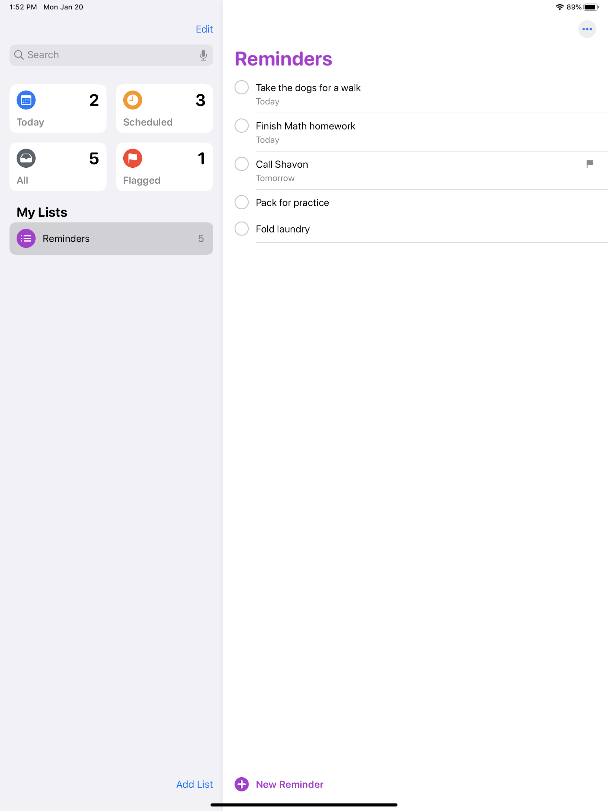
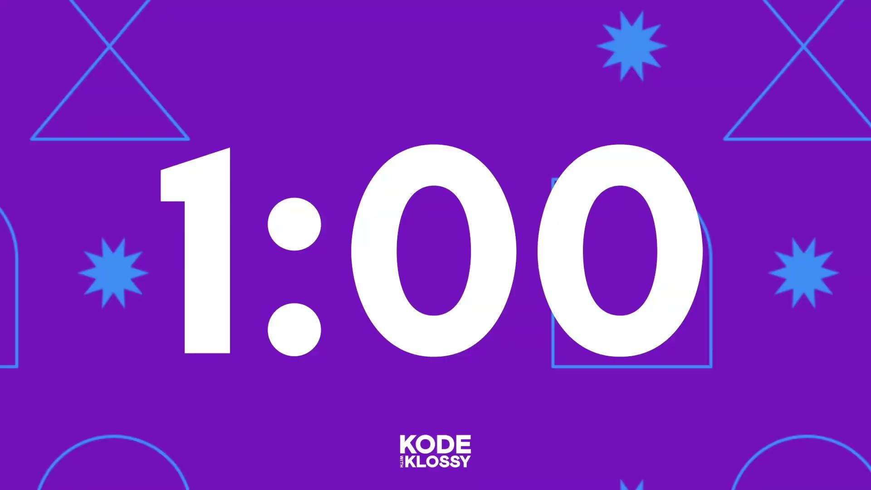
Warm-Up
Create a list of items you need to complete on the Reminders App.
This can be a list for today, the week, or the whole summer!
If you have an iPad, explore the Today, Scheduled, and Flagged features as well.

Slide 115
Discuss
Use the Reminders App (from the Warm-Up) as an example when answering the following questions:
What can the user do?
When do things change on the screen? Is it predictable? Why or why not?
Does the app ever do more than one thing at the same time?

Slide 116
Discussion Takeaways
What can the user do in the Reminders app?
When do things change? Is it predictable?
Does more than one thing ever happen?
Users can create lists and add as many items as they want.
Users can also flag specific list items as important or with a specific due date.
Changes occur only when the user interacts with the app.
The keyboard opens when the user taps the empty area.
The option to flag or delete an item appears when the user swipes left.
When an item is deleted, it’s removed from the list, and the number next to All decreases by one.
All of the behaviors on this app were built by someone who wrote code in the Swift language!

Slide 117
Data Types
A Data Type is a way to classify different kinds of information or data.

Slide 118
Strings
Strings are a series of characters. Types of characters include:
Alpha
Numeric
Spaces
Special characters & emoji
"Hello, World!"
Use double quotes around any characters you want to include in the string.

Slide 119
AM I A STRING?

Slide 120
Directions
Decide whether or not the value is a string!
Be prepared to defend your answer.

Slide 121
ROUND 1
“I love Kode With Klossy”
Yes
No

Slide 122
ROUND 1
“I love Kode With Klossy”
Yes
No

Slide 123
ROUND 2
I love Kode With Klossy
Yes
No

Slide 124
ROUND 2
I love Kode With Klossy
Yes
No

Slide 125
ROUND 3
“1234 I declare a 👍 war”
Yes
No

Slide 126
ROUND 3
“1234 I declare a 👍 war”
Yes
No

Slide 127
ROUND 4
“I am a string
Yes
No

Slide 128
ROUND 4
“I am a string
Yes
No

Slide 129
ROUND 5
‘I am a string now’
Yes
No

Slide 130
ROUND 5
‘I am a string now’
Yes
No

Slide 131
ROUND 6
“Can I finally be a string?”
Yes
No

Slide 132
ROUND 6
“Can I finally be a string?”
Yes
No

Slide 133
Thanks for playing!

Slide 134
Coding Environment: Xcode Playgrounds
Playgrounds are where we will write code to learn, experiment, and build our understanding of Swift as a programming language before we move to Xcode Projects.

Slide 135
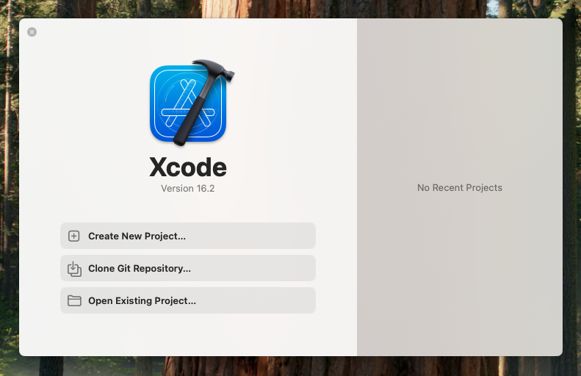
Coding Environment: Xcode Playgrounds
When you launch Xcode, you'll see this screen with options to create a new project or open an existing project. Ignore it!
To open a Playground, go to the menu bar at the top of your screen, select File > New > Playground.
Choose Blank and Save As 1_SwiftDataTypes in a location where you can easily find it later.

Slide 136
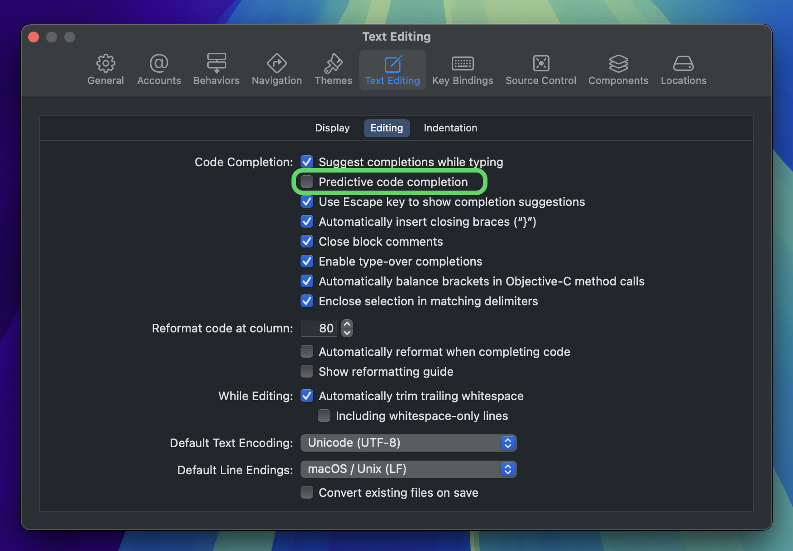
Predictive Code Completion
Go to Xcode > Settings.
Switch to Text Editing and under Editing, uncheck the box next to Predictive code completion.

Slide 137
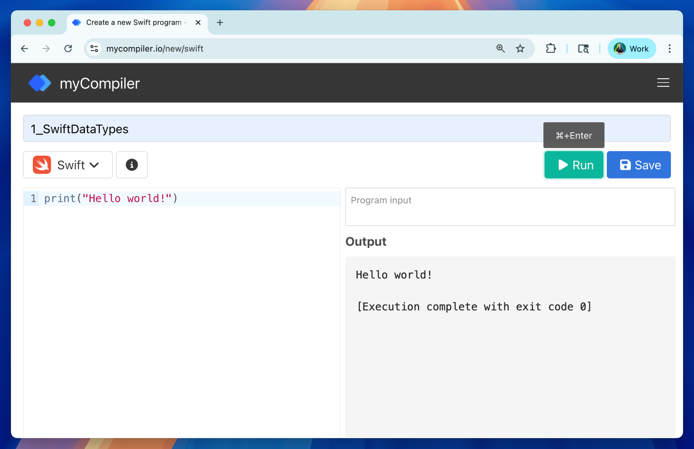
A Temporary Workaround: mycompiler.io
Go to mycompiler.io and select Swift for the language
Rename your program 1_SwiftDataTypes
This is only a temporary solution! Everyone will need to Xcode starting tomorrow. We will work with you to get Xcode up and running today!

Slide 138
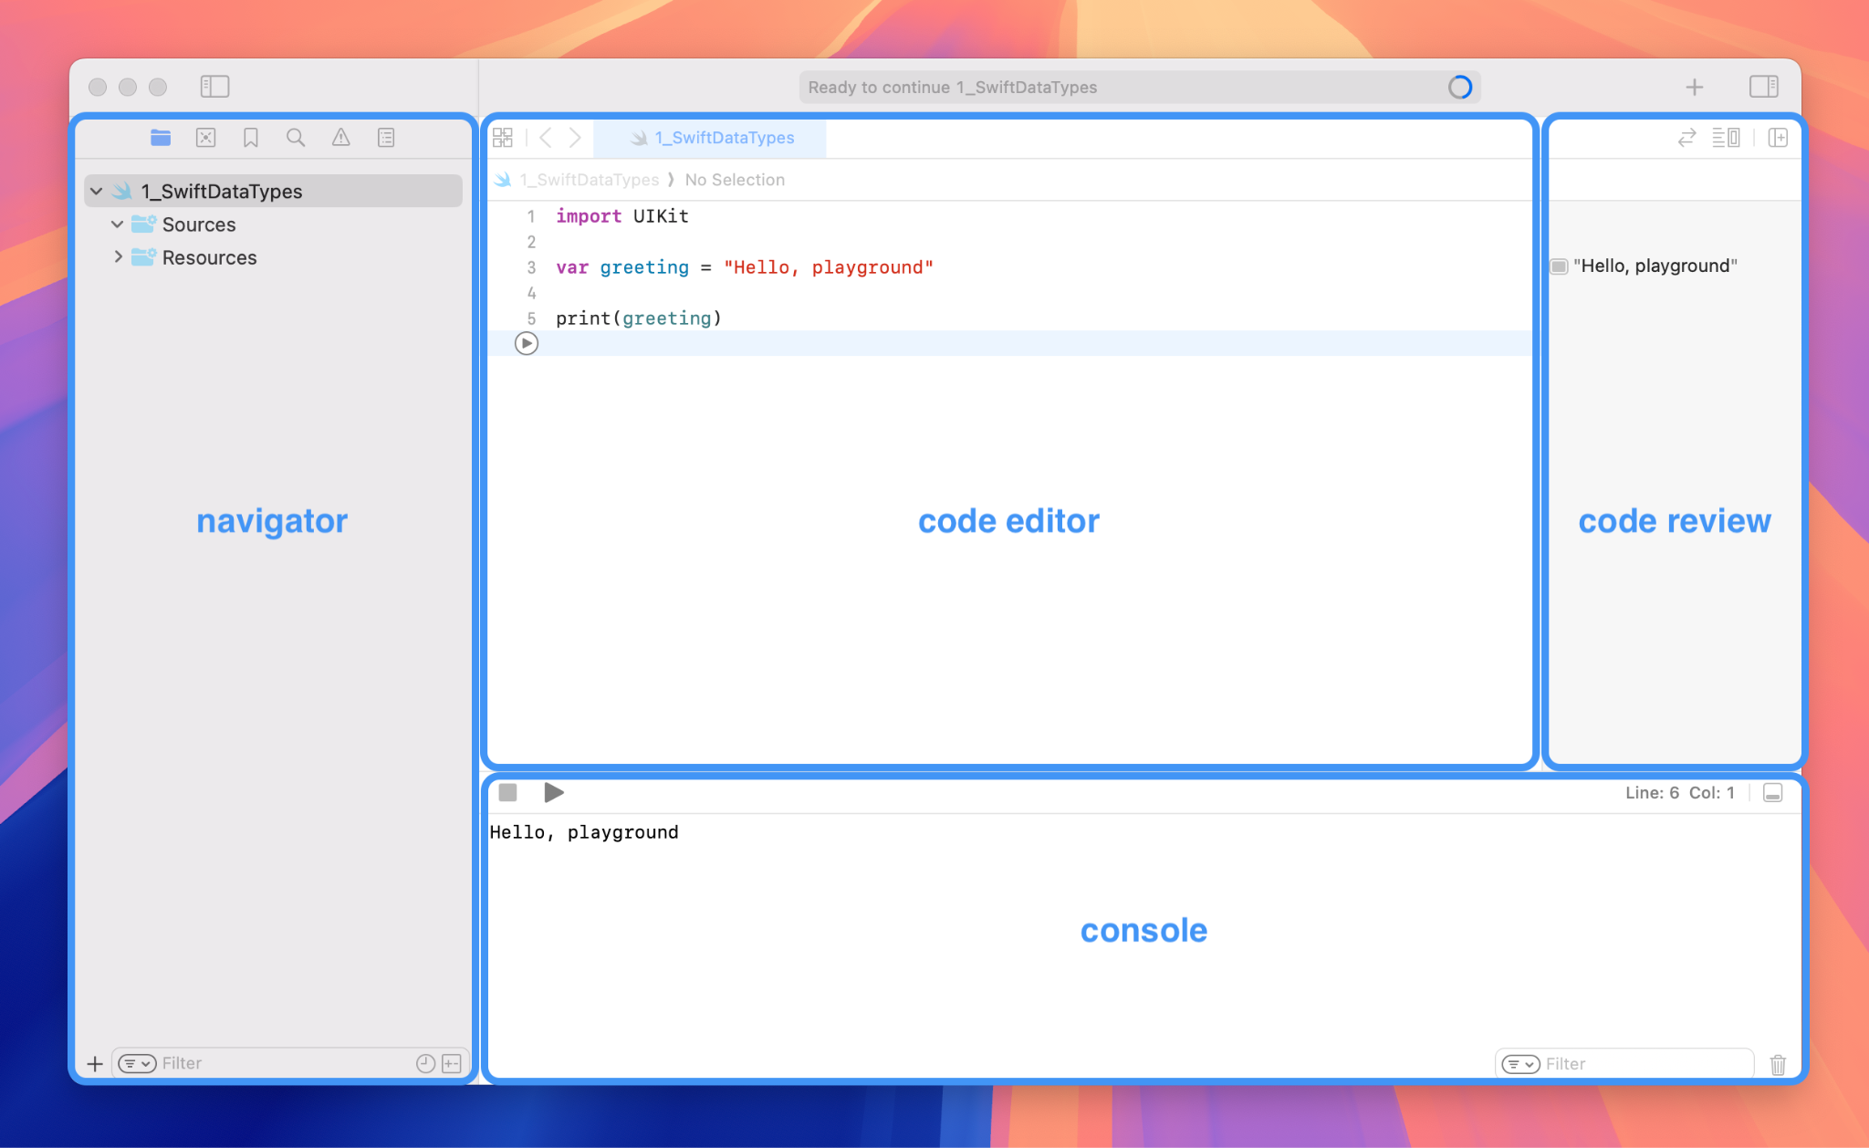

Slide 139
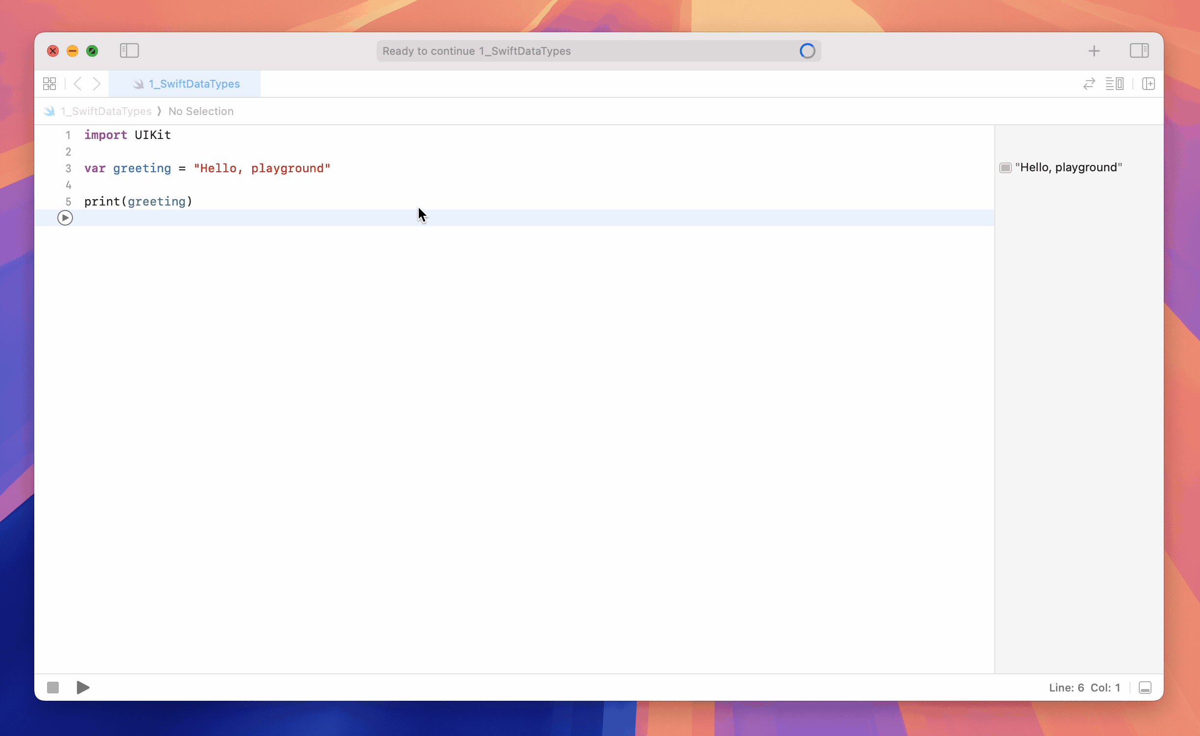

Slide 140
Printing
We use the print() command to print to the console.
Delete all of the starter code in your Xcode playground.
Write a print statement with the string "Hello, World!".
Run your program!
print("Hello, World!")

Slide 141
Commenting
We use comments to write information that won’t impact the functionality of our code.
Comments are helpful to leave notes for ourselves or other developers, as well as for troubleshooting code.
In Swift, the syntax for commenting is:
Keyboard shortcut for commenting:
command + /
// This is a comment

Slide 142
Adding a Comment in Your Code
Let’s add a comment in the code editor explaining what we just did.
// Printing a string to the console
print("Hello, World!")

Slide 143

Try-It | Strings
In your Playground, write print statements to accomplish each task:
Print your first name. Example: print("Karlie")
Print your age.
Print your full name.
Print anything else you want! Use some characters from your keyboard that are not numbers or letters. To access the emoji menu, use the following keyboard shortcut: command + control + spacebar.
Remember to run your code to see your print statements in the console!
Any errors are highlighted in a light red color with an error message. Read the message and try your best to resolve it on your own. If you are still stuck, ask another scholar or instructor!
3 min

Slide 144
Takeaways: Strings
Strings can hold any type of character, including spaces.
The way we type a string is the exact way a computer sees it.

Slide 145
Variables
Pro-Tip: When Naming Variables...
The name of the variable should describe the value it holds
If a variable name consists of more than one word, we use camelCase–the first letter of the subsequent words is uppercase.
Variables are used to store values
Unlike in math class,
variables don’t have to be named x or y
variables don’t just store numbers

Slide 146
To Define a Variable
The var keyword tells Swift that we are about to declare a new variable
Keywords are special, reserved words.
All keywords will be a particular color.
the = sign is used to indicate the value that will be stored in the variable
var listName = "Reminders"
listName is the name chosen for the variable
All of the variables start with a lowercase letter
Use camelCase to name variables consisting of two or more words
The string Reminders is the value that will be stored in this variable

Slide 147
Printing Variables
When we print variables, the value stored in the variable is printed in the console.
For example, when we run print(listName), the value Reminders appears in the console.
Pro-Tip: Use the autofill option when possible. When the autofill option appears, hit the tab key to accept a suggestion.
var listName = "Reminders"

Slide 148
Try-It | Strings and Variables
For each of the prompts below, declare a variable, store a value, and print the variable to the console.
A variable called favoriteColor that holds your favorite color
A variable called pet that holds the name of a pet
A variable called friend that holds the name of a friend
A variable called goal that holds one of your 2025 goals. Remember, you can include spaces in a string!
A variable called hobby that holds one of your hobbies
3 min

Slide 149
Reassigning Variables
Sometimes, we’ll want to change the value stored in a variable. We can change the value using the following syntax. When we reassign a variable, the keyword var is not used.
Defining a variable | var listName = "Reminders"
Reassigning a variable | listName = "Monday To-Dos"
Printing a variable | print(listName) //=> Monday To-Dos

Slide 150
Constants
Constants are used to store values that will NEVER change.
The keyword let declares a constant
The value can be accessed at anytime
The value CANNOT be reassigned
let name = "Karlie"

Slide 151
Think About It: Use for Constants
Come up with 3-4 real life uses for a constant (which is data that will never change).
Are there any places where a constant would be appropriate for the Reminders App? If so, where are constants used?
Be ready to share out!

Slide 152
5 min break break!

Slide 153
Declaring Variables with No Value
Variables can be declared without being assigned a value. This is used when we don’t have the information yet.
To declare a variable with no value in Swift, we have to declare the type of data that will be stored.
var name : String
keyword | name of variable | : (colon) | data type

Slide 154
Assigning Values to Empty Variables
var name : String
var lastNumber : Int
name = "Karlie"
lastNumber = 78
When we have the data and are ready to assign values to empty variables:
We use the same syntax as when we reassign values to variables
Make sure the the value is the appropriate data type
For example, we will not be able to store the value 78 into the variable name

Slide 155
String Interpolation
We can use string interpolation to insert a variable into a string. The syntax \( ) tells the computer to replace the variable with its value.
var listName = "Reminders"
var totalReminders = "five"
print("There are \(totalReminders) items on the \(listName) list.")
//=> There are five items on the Reminders list.

Slide 156
Try-It | String Interpolation
Declare the following variables:
var first = "Karlie"
var last = "Kloss"
Use string interpolation to print the the following outputs
Output the string "Hi Karlie"
Output the string "KlossKarlie"
Output the string "Karlie Kloss"
Output the string "Kloss Karlie Kloss Karlie"
Output the string "Karlie Kloss loves Kode With Klossy!!!"
3 min

Slide 157
Numbers
Numbers are another data type used in Swift.
Integers
Doubles
A data type that is a whole number.
1, 42, 3, -56, 0
A data type that is a decimal number.
1.1, 42.45, 3.14, -0.1937234

Slide 158
Storing Numbers in Variables
We can store integers and doubles in variables.
Let’s take a closer look at the variable outsideTemperature.
Do you think 60.0 is an integer or a double?
var totalReminders = 5 var bodyTemperature = 98.6 var dayOfCamp = 1 var outsideTemperature = 60.0

Slide 159
Storing Numbers in Variables
We can store integers and doubles in variables.
Let’s take a closer look at the variable outsideTemperature.
Do you think 60.0 is an integer or a double? It’s a double!
var totalReminders = 5 var bodyTemperature = 98.6 var dayOfCamp = 1 var outsideTemperature = 60.0

Slide 160
Math with Doubles and Integers
var integer = 4
var double = 5.0
integer * double // --> ERROR
We can’t perform math operations on a double and an integer because they are different data types.
var integer = 4
var double = 5.0
Double(integer) * double // --> 20.0
integer * Int(double) // --> 20
To perform math operations on an integer with a double, convert the integer into a double and the final answer will be a double.

Slide 161
String Interpolation with Numbers
We can also interpolate with variables that hold numbers.
var listName = "Reminders"
var totalReminders = 5
print("There are \(totalReminders) items on the \(listName) list.")
//=> There are 5 items on the Reminders list.

Slide 162
Practice: Data Types
For each item on the list below, determine if it should be stored as a variable or constant. Be ready to explain your thinking.
scholarName
address
cityBornIn
gradeLevel
birthday
age
eyeColor
myFavoriteColor
idNumber

Slide 163
Practice: Data Types
For each item on the list below, determine if it should be stored as a variable or constant. Be ready to explain your thinking.
scholarName
address
cityBornIn
gradeLevel
birthday
age
eyeColor
myFavoriteColor
idNumber
Declare variables or constants for each of the items listed to the left, and assign an appropriate value.

Slide 164
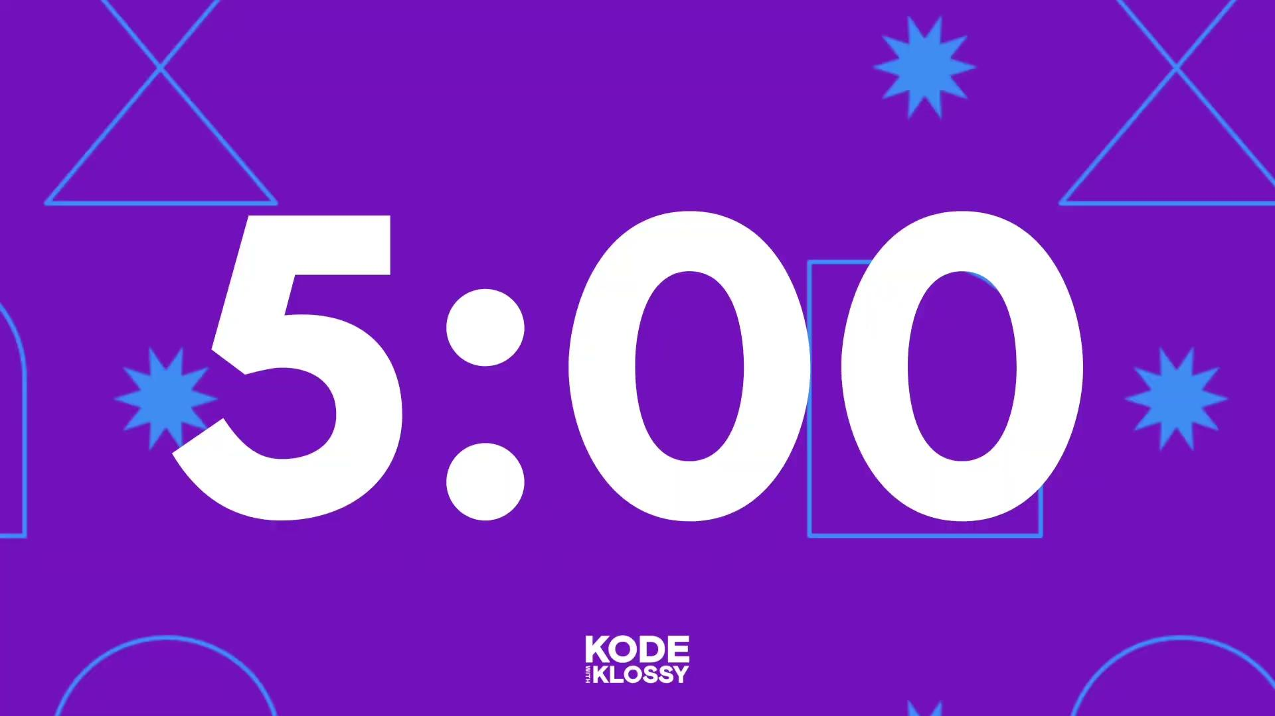
Practice: Data Types
For each item on the list below, determine if it should be stored as a variable or constant. Be ready to explain your thinking.
scholarName
address
cityBornIn
gradeLevel
birthday
age
eyeColor
myFavoriteColor
idNumber
Declare variables or constants for each of the items listed to the left, and assign an appropriate value.
Use string interpolation to print at least 3 different sentences about yourself to the console, using at least one variable in each sentence.

Slide 165
Practice
Reference the practice in the lesson for details!

Slide 166
Takeaways
The main data types in Swift are strings, integers, and doubles
Use the var or let keywords to declare variables or constants
Variables and constants allow us to store information with a label to reference later in our code
Use the print() function to display output in Xcode playgrounds and // to comment out a line of code
String interpolation is when we insert variables into longer strings

Slide 168
Extensions

Slide 169
Incrementing with Numbers

Slide 170
Discuss: Incrementing Numbers
Incrementing numbers (like the snippet below) is something developers do very frequently. Let’s revisit our totalReminders variable from earlier.
With your partner, brainstorm some uses of numbers incrementing (or decrementing) in apps.
var totalReminders = 0
// Reassign totalReminders to its previous value (0) plus 1
totalReminders = totalReminders + 1
// => 1
// Reassign totalReminders to its previous value (1) plus 1
// This is a shortcut that does the exact thing as the example above!
totalReminders += 1
// => 2

Slide 171
Discussion Takeaways
Examples of number incrementing (or decrementing)
On a user’s birthday, an app should increment their age.
Social media apps use incrementing to keep track of the number of likes, replies, followers, etc.
Scheduling apps might have a countdown to a specific date.

Slide 172
Try-It | Incrementing Numbers
Declare a variable that stores the current day of Kode With Klossy camp. The variable should be assigned to the integer value 1 because today is the first day of camp!
Write a line of code that increases the day of camp by one. Print your variable.
Use string interpolation to print the phrase "Welcome to day 2 of Kode With Klossy camp!" to leave for yourself tomorrow!
Extension: Code one of the examples of incrementing numbers in an app you brainstormed with your partner earlier.
🌶️ To make it even more challenging, try to think of an example where you’d be incrementing by a number other than one.

Slide 173
Math Operations with Swift

Slide 174
Math Operations with Swift
We can do math operations with numbers. | All math operations follow the Order of Operations (i.e. PEMDAS)
3 + 5 //=> 8 12 / 2 //=> 6 18 - 8 //=> 10 | (3 + 2) * 8 // 5 * 8 //=> 40

Slide 175
Math with Variables
We can also perform math operations on variables, if (and only if) those variables hold numbers.
var numberOfScholars = 30
var scholarsPerFinalProjectGroup = 3
var numberOfFinalProjectGroups = numberOfScholars / scholarsPerFinalProjectGroup
print(numberOfFinalProjectGroups)
//=> 10
print("Because we have \(numberOfScholars) scholars and each final project group is made of \(scholarsPerGroup) scholars, we will have a total of \(numberOfFinalProjectGroups) final project groups.")
//=> "Because we have 30 scholars and each final project group is made of 3 scholars, we will have a total of 10 final project groups"

Slide 176
Try-It | Integers and Operators
Start with the following numbers:
Write code to find the average of these four temperatures.
Remember, average (or mean) is calculated by dividing the sum by the number of numbers!
Find the average using paper or a calculator. Is your answer different than you found with Swift? Why might that be?
What is the result for the following expression?
januaryAvg + marchAvg * novemberAvg / julyAvg
What other outputs can you get out by adding one or more pairs of parentheses to the expression?
Medium Challenge: Find the answer to this problem using Swift:
A rocket traveled at 3000 mph on the way to fix the Hubble Space Telescope. On the way back, it was traveled at 1000 mph. What was the average speed?
Print out to the console your answer in a complete sentence.
var januaryAvg = 12
var marchAvg = 65
var novemberAvg = 31
var julyAvg = 98

Slide 177
Math with Integers and Doubles
var januaryAvg = 12
var marchAvg = 65
var novemberAvg = 31
var julyAvg = 98
var total = (januaryAvg + marchAvg + novemberAvg + julyAvg)
print(total / 4)
// => 51
In the previous Try-It section, Swift calculated the average of the four temperatures to be 51, even though (we can verify on a calculator) that the more precise answer is 51.5.
What happened and how can we fix this?

Slide 178
Converting Integers to Doubles
var januaryAvg = 12
var marchAvg = 65
var novemberAvg = 31
var julyAvg = 98
var total = (januaryAvg + marchAvg + novemberAvg + julyAvg)
print(Double(total) / 4.0)
// => 51.5
We would need to use a double to ensure a more precise and accurate answer.
On the last line of code in the snippet, we converted the total of the 4 temperatures into a double with the Double(total) syntax. That changed 206 to 206.0. It seems like a small difference to us, but it is a big difference to Swift.

Slide 179
Try-It | Math with Integers and Doubles
Tutoring Totals
Jade tutors part-time and earns $12.50 per hour. They worked 15 hours last week. How much should they get paid?
Create variables to represent all the numbers in this problem and print a complete sentence with the total Jade should be paid.
Night Shift Grind
Celine’s base pay is $13.75 per hour. She is paid an additional $2.50 per hour because she works the night shift. She worked 25 hours during the night last week.
Create variables to represent all the numbers in this problem and print a complete sentence with the total Celine should be paid.

Slide 180
Brain Break

Slide 181
Swift: Conditional Statements

Slide 182
Use comparison operators to compare variables, strings, and numbers
Explain the purpose of conditional logic
Write if, else if, and else statements

Slide 183
Boolean
Condition
Conditional statements
Evaluate
Expression
Operators
Statement

Slide 184
Getting Started
Create a new Xcode playground and save it as 2_ConditionalStatements.
Make sure you save it somewhere you can find it again later!

Slide 185

Warm-Up: Crack the Code!

Slide 186
Warm-Up: Crack the Code!
7
2
9

Slide 187
Warm-Up: Crack the Code!
How could we write a program in Swift to play this game?

Slide 188
Comparison Operators
3 < 5
//-> true
4 >= 9
//-> false
7 == 7
//-> true
"karlie" == "karlie"
//-> true
"karlie" == "Karlie"
//-> false
"karlie" != "Karlie"
//-> true
We write expressions to compare 2 values against each other.
We are able to compare two values by using comparison operators.
Each expression is evaluated to a boolean (boo-lee-uhn), true or false.

Slide 189
List of Comparison Operators
3 < 5
//-> true
4 >= 9
//-> false
7 == 7
//-> true
"karlie" == "karlie"
//-> true
"karlie" == "Karlie"
//-> false
"karlie" != "Karlie"
//-> true
<
>
<=
>=
==
Less Than
Greater Than
Less Than or Equal To
Greater Than or Equal To
Equal To

Slide 190
What’s the difference between == and =?

Slide 191
What’s the difference between == and =?
The equal-to operator (==) checks if two pieces of data are equal to each other.
The assignment operator (=) assigns the value to a variable.

Slide 192
Explore: Operators
Look at each expression below and the value it evaluates to.
Then, try to determine the function of the(!=)operator:
3 != 4
//-> true
5 != 5
//-> false
4 != 9
//-> true

Slide 193
Explore: Takeaway
Look at each expression below and the value it evaluates to.
Then, try to determine the function of the != operator:
3 != 4
//-> true
5 != 5
//-> false
4 != 9
//-> true
!=: not equal operator
Checks if two values are not equal.
The opposite of the == operator.

Slide 194
Comparing Variables
Comparison operators can also be used to compare variables.
It is the value stored in the variable that is evaluated.
var language = "Swift" language == "swift" //-> false language == "Swift" //-> true "swift" == language //-> false | var year = 2025 var nextYear = 2026 year > 2000 //-> true year != 2019 //-> true year < nextYear //-> true

Slide 195
Try-It | Comparison Operators
Declare two variables (firstName and age) and assign them the appropriate values. Generally, you declare variables at the top of a code file.
Remember to use print() to print your output to the console. Check for the following things:
Is your name the same as "Karlie"?
Is your age the same as 15?
Is your age not the same as 15?
Is your age greater than 7?
Is your age less than or equal to 10?
Medium Challenge 🌶🌶 Have you ever tried to create a password, but the application told you it needs to be at least 8 characters? Time to solve a real-world challenge!
Declare a new variable called fakePassword and assign it to a string of your choice.
Then, check that fakePassword is at least 8 characters long.
Change the value assigned to fakePassword to make sure it's working as expected.

Slide 196
Break Break
Step away if you really need to – we’re going to power through!

Slide 197
What are Conditional statements?
Conditional statements instruct our program to do something only if a certain condition is met.

Slide 198
Comparing Decisions IRL vs Programming
IRL Example
Programming Example
Am I hungry?
Yes → I’ll eat
No → I won’t eat
Do you have an account?
Yes → Please log in
No → Please create an account
Can you think of some examples of apps that you like where the developers may have used conditionals?

Slide 199
Conditional Statements
Conditionals statements can be thought of as a set of questions each with different possible outcomes.
Each outcome depends on the answer (true or false) to each question.
var queen = "Beyoncé"
if queen == "Beyoncé" {
print("You are correct!")
} else {
print("Beyoncé is the only queen.")
}
‹#›

Slide 200
How do Conditional Statements Work?
var queen = "Beyoncé" if queen == "Beyoncé" { print("You are correct!") } else { print("Beyoncé is the only queen.") } | // new variable created // program checks for this condition // if it evaluates to true, it will execute this block // if it evaluates to false, it will execute this block
‹#›

Slide 201
Try-It | Conditional Statements
Remember to use print() to print your output or feedback in the console.
Create a variable named score and assign it to a number representing a test score.
Write an if statement that checks whether the student passed or failed the test. If score is greater than or equal to 70, print "Congratulations! You passed!" Otherwise, print "Keep trying!"
🌶🌶 Medium Challenge
Create a variable named myNumber and assign it a number of your choice.
Write an if statement that checks whether myNumber is positive or negative. If it is positive (greater than 0), print "Your number is positive!" Otherwise, print "Your number is negative!"
🌶🌶🌶 Spicy Challenge
Create a variable named secretNumber and assign it to a number between 1 and 10.
Create another variable named guess and assign it to a different number.
Write a conditional statement to respond differently based on the guess. If guess is equal to the secretNumber, print “Congratulations! You guessed it!” Otherwise, print “Try again!”
‹#›

Slide 202
Coding Additional Outcomes
We can use else if to code additional outcomes
var queen = "Beyoncé"
if queen == "Beyoncé" {
print("You are correct!")
} else if queen == "Blue Ivy" {
print("Technically she is a queen in training...")
} else {
print("Beyoncé is the only queen.")
}

Slide 203
Conditional Statements: Takeaways
We can use any comparison operator in a condition
We can use strings or numbers in a condition
If a condition evaluates to true, the code block below will run
Only one block of code will run in a conditional block

Slide 204
Try-It | Checking Multiple Conditions
Create a variable named favoriteFood and assign it to a string representing your favorite food.
Write an if statement that checks if favoriteFood is "Chipotle". If true, print a sentence of your choice.
Add an else if statement that checks if favoriteFood is "Starbucks", printing another sentence.
Add a second else if statement comparing favoriteFood to a food of your choice.
Finish with an else statement that prints a sentence for any other food.
Test your code by changing favoriteFood to "Chipotle", then "Starbucks". Do you get the expected results?
🌶🌶 Medium Challenge
Write a program that checks a string. It should print to the console "even" if the number of characters in the text is even, and "odd" if the number of characters in the text is odd.
🌶🌶🌶 Spicy Challenge
Create a variable named secretNumber and assign it to a number between 1 and 10.
Create another variable named guess and assign it to a different number.
Write a conditional statement to compare guess to secretNumber. If guess is equal to secretNumber, print "Congratulations! You guessed it!" If guess is greater than secretNumber, print "Too high! Try again." If guess is less than secretNumber, print "Too low! Try again."

Slide 205
Practice
Reference the practice in the lesson for details!
Be sure to try out the Logical & Modulo Operators extensions!

Slide 206
Extensions

Slide 207
Logical Operators
Logical operators allow us to do some powerful work with conditionals:
var language1 = "JavaScript" var language2 = "Swift" print((language1 == "JavaScript") || (language2 == "JavaScript")) //=> true print((language1 == "Swift") || (language2 == "Swift")) //=> true | print((language1 == "Python") || (language2 == "Python")) //=> false print((language1 == "JavaScript") && (language2 == "JavaScript")) //=> false print((language1 == "Swift") && (language2 == "Swift")) //=> false

Slide 208
List of Logical Operators
Logical OR
Logical AND
||
&&
The logical OR operator || requires either statement to be true for the overall statement to be true.
The logical AND operator && requires both statements to evaluate to true for the overall statement to be true.

Slide 209
Try-It | Logical Operators
Continue writing all of your code in the same Xcode playground. Remember to use print() to see the output of your statements.
Assign two variables, firstName and age, to appropriate values. Now, check for the following things:
Is your age less than 30 and greater than 10?
Is your age less than 20 or greater than 10?
Is your age exactly 15 or less than 18?
Is your age greater than 12 or exactly 14?
Is your age greater than 10 but not exactly 16?

Slide 210
Explore: Modulo Operator
Look at the code snippet below and the value it evaluates to.
Then, try to determine the function of the (%) (modulo) operator:
11 % 2
//-> 1
32 % 6
//-> 2
16 % 3
//-> 1

Slide 211
Explore: Takeaway
Look at the code snippet below and the value it evaluates to.
Then, try to determine the function of the (%) (modulo) operator:
11 % 2
//-> 1
32 % 6
//-> 2
16 % 3
//-> 1
%: modulo operator
Finds the remainder of two numbers.
A helpful tool to determine if numbers are even or odd.

Slide 212
Try-It | Modulo Operator
What is the remainder when 27 is divided by 9?
What is the remainder when 100 is divided by 13?
What is the remainder when your age is divided by 2?

Slide 213
Closing Circle

Slide 214
End-Of-Day Reminders
‼️ Submit Your Artifacts in Your House ‼️
Be sure to copy your Xcode Playground code from the Lesson 3- Conditional Statements Practice into the designated thread in your House channel!
🕠 Office Hours 🕡
Tonight: Mishu, Christine, and Amulya will be hosting from 6pm-7pm
😴💻 Night Hack 💻😴
Swift: Data Types & Variables Practice + Extensions + Spicy Challenges
Conditional Statements Practice + Extensions + Spicy Challenges
Tech Check with Xcode

Slide 215
Sneak Peek for Tomorrow
Morning Session
9:30 - 9:50 | Opening Circle
9:50 - 12:00 | 4. Swift: Arrays & Loops Brain Break 5. Swift: Functions & Closures
Afternoon Session
12:45 - 2:40 | 6. SwiftUI: Views, Stacks, & Modifiers Brain Break Culture of Tech (Part 2): KWK & Me
2:40 - 3:00 | Closing Circle + Microfeedback

Slide 216
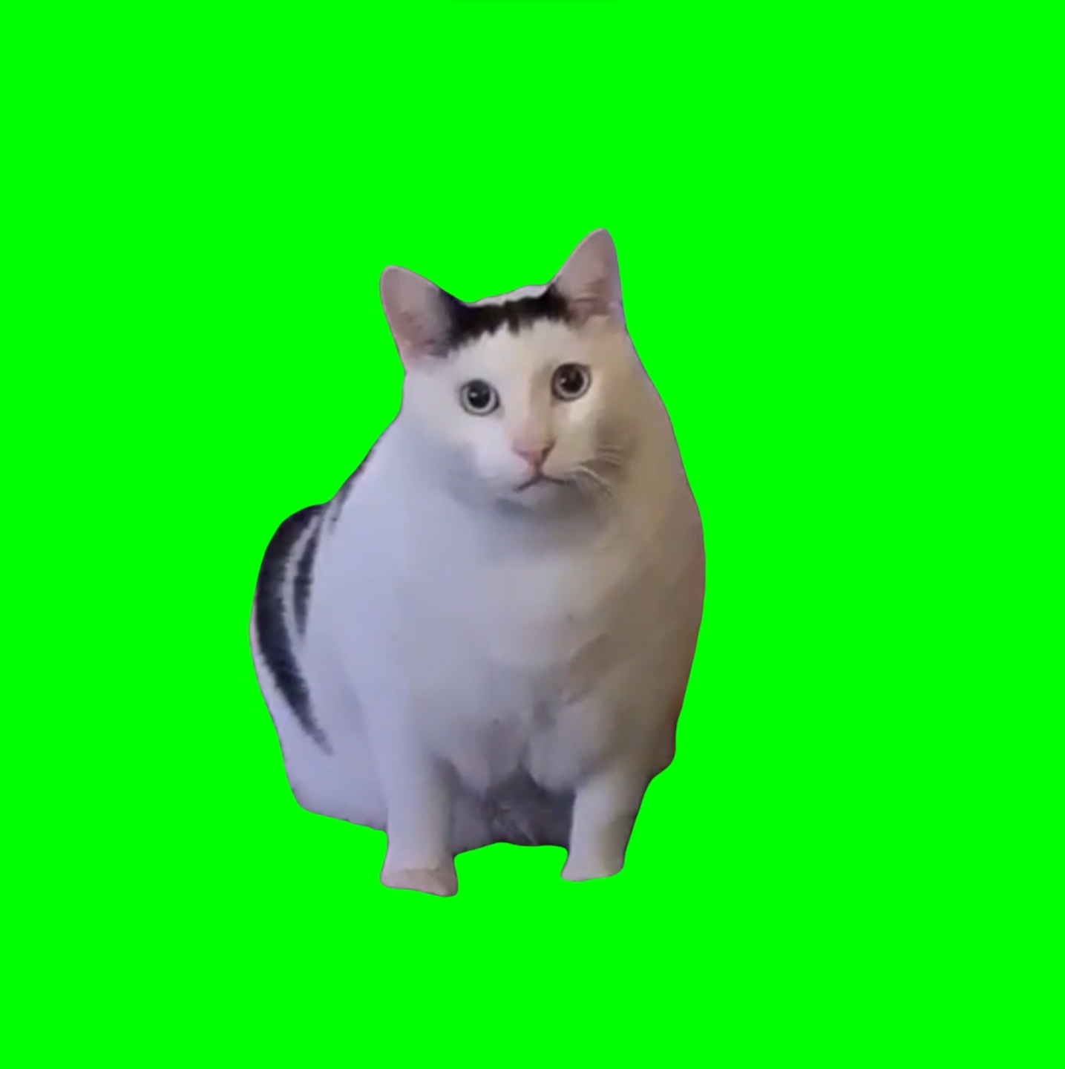

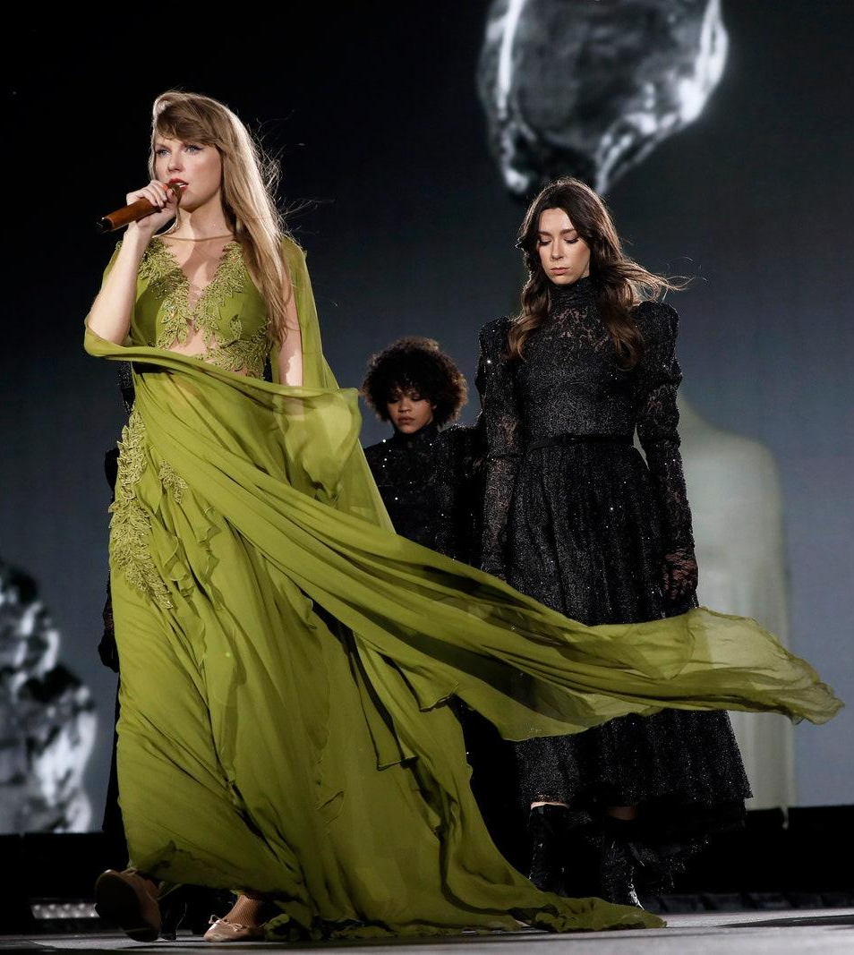


Tomorrow’s theme is…
Kode With Klossy Green!

Slide 217
Microfeedback

Slide 218
Microfeedback
Microfeedback is a daily survey you take at the end of the day.
Your feedback MATTERS!

Slide 219
Learning Zones
Comfort Zone
Learning Zone
Alarm Zone
Feels cozy and predictable.
Everything falls within your wheelhouse.
Not pushing yourself to learn anything new
Sticking to what you already know.
Feels challenging and exciting!
Stepping outside your comfort zone to learn something new!
Might feel uncomfortable, this is where the real growth is!
Feels stressful and overwhelming.
Information overload, leading to lack of motivation.
Ring the alarm to inform your instructional team - we’re here to help!

Slide 220
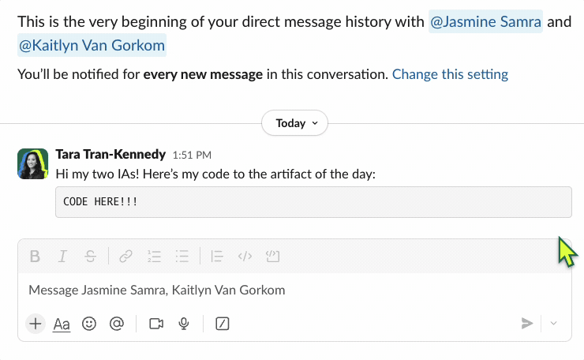
Submit Your Artifact in Your Microfeedback
For your Artifact of the Day, submit your Lesson 3 - Swift: Conditional Statements Practice!
Once you copy your message link, submit the link in your microfeedback form!

Slide 221
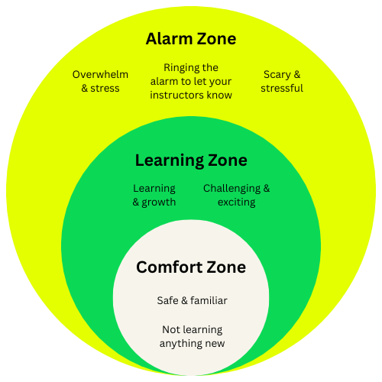

Complete Your Microfeedback
For your Artifact of the Day, submit your Lesson 3 - Swift: Conditional Statements Practice!

Slide 222
House Breakouts

Slide 223

Have a great rest of your day and see you all tomorrow! 🤗

